Slide 1
VX423 Student Presentation SIIDI
Pan Chongdan
Mar. 30th

Slide 2

Introduction of SIIDI
A world-class practical research of design and innovation
Sustainability Research
Transportation Ecosystem
Urban Quality Living
High Tech Big Data Service
Dutch Sustainability Day
Innovation Service
Mental Management
Innovative Thinking
Leadership Execution
Field Practice

Slide 3
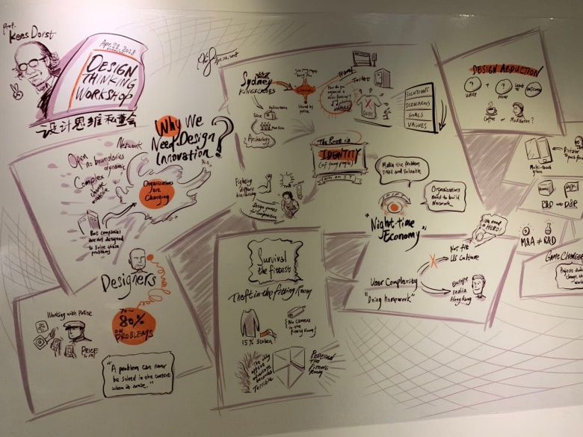
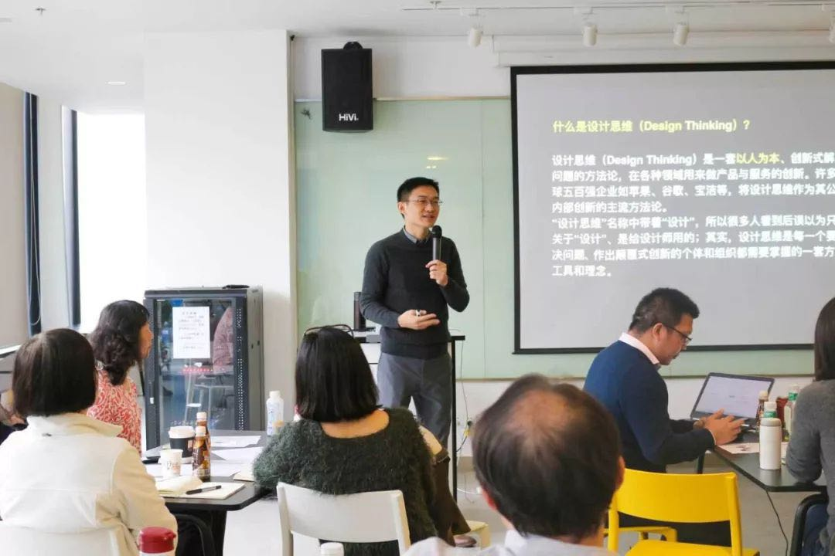
Intrapreneurship in SIIDI
Innovation Culture
White boards for workers to draw innovative ideas
Pictures to teach workers how to make intrapreneurship in the company
Workshop by Mentors
A volunteer opportunity for design thinking workshop
Cultivate workers to learn innovative thinking for Intrapreneurship

Slide 4
Opportunity: Waste Management Project
An intrapreneurship project including a smart bin, identifiable rubbish bag and rubbish transport planning system
Government rules change
Chinese government issued a rule which requests citizens to classify their garbage.
Technological development
Fully-developed GPS can be applied to a garbage truck.
QR code can be used to identify information
Lifestyle changes
Mobile phones are playing an important role in everyone’s life
Smart bin
Get information from users when opened
Check garbage classification status
Monitor garbage volume
Rubbish Bag
Environmentally friendly
With QR code to identify their users
Garbage truck
Equipped with GPS to get the most efficient route to transport the rubbish.

Slide 5
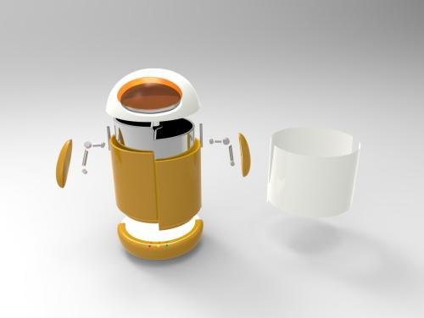
Opportunity: Waste Management Project
Cooperative Corporative Venturing
Develop the prototype with other manufacturers together.
Cooperate with various universities to employ different technicians who specialize in particular fields.
Strategic Renew
Keep making field visits to assure that the project is realizable at specific places
Hold a meeting regularly to adjust following plan and strategy.
Technology Innovation
Smart bin
Smart route plan system
Design Innovation
Highly efficient and environmentally friendly
Provide the best user experience

Slide 6
Improvements for intrapreneurship process
Trouble for Intrapreneurship
Workers are too young and lack enough practical experience
The brand is not well known enough and sometimes the company may lack clients
The company mainly focuses on making social welfare and needs funds from the government
Competitor
Professional institute which focuses on specific field
Possible Action
Hold more intrapreneurship workshop and cooperate with other companies to exchange worker experience.
Do more advertisement on the Internet to raise publicity
Expand more profitable business and become high self-sufficiency
Employ more experts specialized in specific fields

Slide 7
Thank you!

